Slide 1
Addressing Maternal Healthcare Disparities in Rural Communities Through Telemedicine Solutions
Hassan Ahmad, Muhammad Abdullah, Waleed Ishtiaq, Talha Dogar, Muhammad Ali

Slide 2
CONTENTS
Introduction
Literature Review
Methodology
Discussion
Results and Recommendations
Proposed Solution and Conclusion

Slide 3
INTRODUCTION

Slide 4
INTRODUCTION
Maternal Healthcare Disparities in Rural Communities:
Challenges Impacting Rural Maternal Care:
Telemedicine Solutions: Addressing Disparities in Maternal Healthcare:
Overview of limited access, rural isolation, and awareness gaps affecting maternal and infant well-being in rural areas.
Discussion on healthcare provider shortages, geographic barriers, socioeconomic factors, cultural hindrances, and inadequate infrastructure in rural settings.
Apps and platforms help streamline user experience
Seek expert guidance from Krypto Logics team members​

Slide 5
Literature Review
Telemedicine in Maternal Healthcare:
mHealth Integration in Rural Health Services:
Telemedicine Solutions: Addressing Disparities in Maternal Healthcare:
Definition, forms, and challenges of telehealth adoption in maternal care, emphasizing the potential benefits and obstacles faced.
The role of ASHAs in India's NRHM, their integration with mobile technology, and the impact of mHealth on maternal and child health services.
A comprehensive review of telehealth interventions, focusing on maternal mental health, diabetes during pregnancy, and potential disparities and uncertainties in outcomes.

Slide 6
Methodology
Three Delays Model

Slide 7
TRADING & INVESTING
Crypto can be complicated but getting started doesn’t have to be

Slide 8
LONG-TERM VS. SHORT-TERM

Slide 9
GLOBAL CURRENCY MARKETS
 | $USD | £EUR | ¥JPY | ₿BTC
Q1 | 4.5 | 2.3 | 1.7 | 5.0
Q2 | 3.2 | 5.1 | 4.4 | 3.0
Q3 | 2.1 | 1.7 | 2.5 | 2.8
Q4 | 4.5 | 2.2 | 1.7 | 7.0

Slide 10
WEALTH IS THE ABILITY TO FULLY EXPERIENCE LIFE.
-Henry David Thoreau

Slide 11
TYPES OF TOKENS
Payment
Utility
Security
NFT
Gaming
Used to complete transactions anywhere crypto is accepted
These tokens have a specific use within a blockchain
Tokens backed by securities
Authenticates ownership of specific assets
Used as in-game currency and traded with real world value

Slide 12





PORTFOLIO BUILDUP
Step 1
Step 2
Step 3
Step 4
Step 5
Choose a cryptocurrency exchange
Purchase preferred coins & create "wallet"
Research investment and trading options
Stake preferred coins in chosen company
Set exponential growth goals

Slide 13
AREAS OF FOCUS
Portfolio diversification
Short and long-term goals
Develop winning combinations to stay ahead of the market
Capitalize on direct ownership of digital coins
Invest in multiple blockchains​
Create an emergency fund
Add a second stream of income
Buy a house
Supplement retirement fund

Slide 14

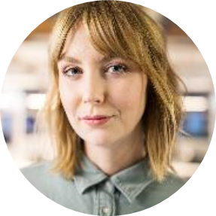
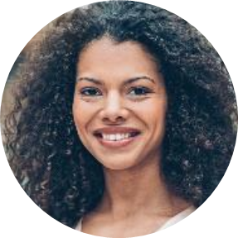
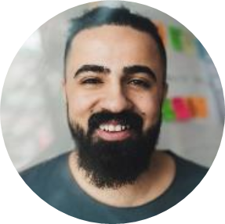
MEET OUR TEAM
Takuma Hayashi​
Mirjam Nilsson​
Flora Berggren​
Rajesh Santoshi​
President
Chief Executive Officer
Chief Operations Officer
VP Marketing

Slide 15
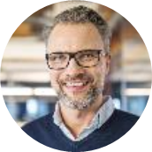
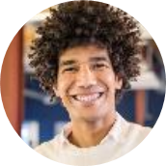
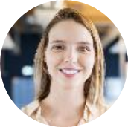

MEET OUR EXTENDED TEAM
Takuma Hayashi​
Mirjam Nilsson​
Flora Berggren​
Rajesh Santoshi​
President
Chief Executive Officer
Chief Operations Officer
VP Marketing
Graham Barnes
Rowan Murphy
Elizabeth Moore
Robin Kline
VP Product
SEO Strategist
Product Designer
Content Developer

Slide 16
SUMMARY
At Krypto Logics, we believe in giving 110%. By using our next-generation data architecture, we help investors virtually manage their portfolios. We thrive because of our market knowledge and great team. As our CEO says, "Efficiencies will come from proactively transforming how we do business."

Slide 17
THANK YOU
Mirjam Nilsson​
mirjam@greatsiteaddress.com
www.greatsiteaddress.com

